Slide 1
Module 2
Memory Organization of 8051 Microcontroller

Slide 2
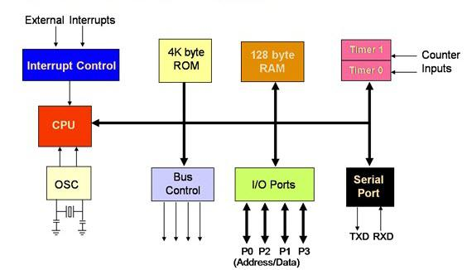
8051 ARCHITECTURE

Slide 3
MEMORY ORGANIZATION-8051
The 8051 has two types of memory and these are Program Memory and Data Memory.
Program Memory (ROM) is used to permanently save the program being executed, while Data Memory (RAM) is used for temporarily storing data and intermediate results created and used during the operation of the microcontroller.
Depending on the model in use 8051 microcontroller family in general have at most a few KB of ROM and 128 or 256 bytes of RAM is used.
All 8051 microcontrollers have a 16-bit addressing bus and are capable of addressing 64 kB memory.

Slide 4
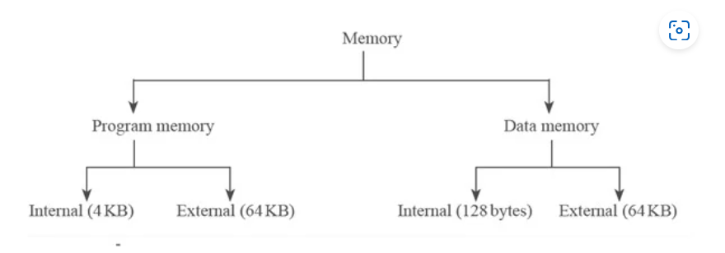

Slide 5
The first models of the 8051 microcontroller family did not have internal program memory. It was added as an external separate chip.
Even though such an amount of memory is sufficient for writing most of the programs, there are situations when it is necessary to use additional memory as well. A typical example is so called lookup tables.
They are used in cases when equations describing some processes are too complicated or when there is no time for solving them. In such cases all necessary estimates and approximates are executed in advance and the final results are put in the tables (similar to logarithmic tables).

Slide 6
EA=0 In this case, the microcontroller completely ignores internal program memory and executes only the program stored in external memory.
EA=1 In this case, the microcontroller executes first the program from built-in ROM, then the program stored in external memory

Slide 7
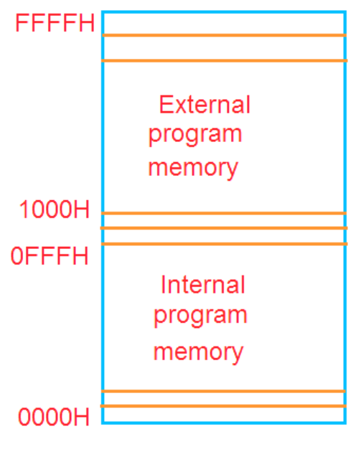
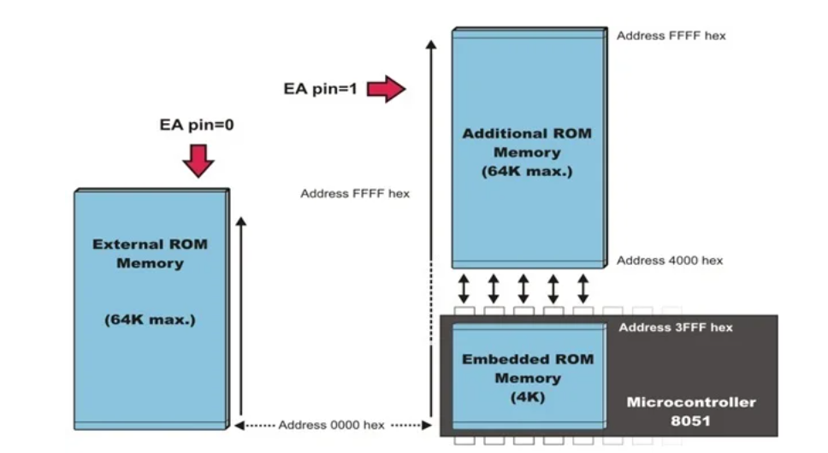
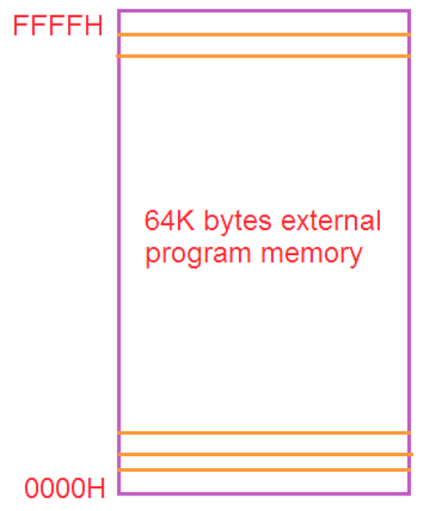
MEMOERY ORGANIZATION-ROM

Slide 8
Data Memory Organization of 8051
RAM ORGANIZATION
This part of RAM is divided in several blocks.
The first block consists of 4 banks each including 8 registers denoted by R0-R7. The PSW has two bits for identifying the register bank, i.e., 00 represents bank 0, 01 represents bank 1, 10 represents bank 2, and 11 represents bank 3.
Prior to accessing any of these registers, it is necessary to select the bank containing it.

Slide 9
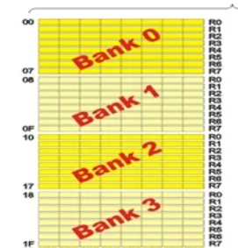
REGISTER BANKS

Slide 10
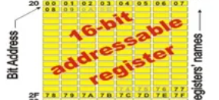
The next memory block (address 20H-2FH) is bit- addressable, which means that each bit has its own address (0-7FH). The bit-addressable memory is both bit-addressable (from 00H to 7FH) and byte-addressable (from 20H to 2FH). Bit operations are helpful in many control algorithms.

Slide 11
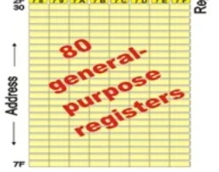
The third group of registers occupies addresses 2FH-7FH, i.e. 80 locations, and does not have any special functions or features.

Slide 12
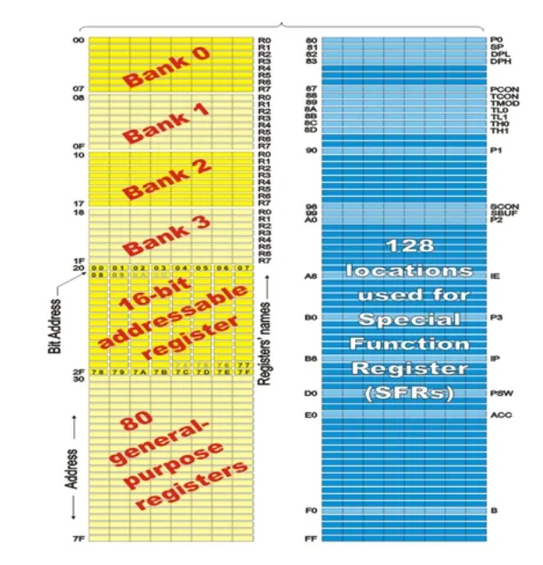
RAM MEMORY

Slide 13
Special Function Registers (SFRs)
SFR, which occupies upper 128 bytes of internal memory are the registers, that control the entire processor
They can be accessed by DIRECT addressing.
Programmers should not use the addresses in the range 80H to FFH (other than SFR) as it is used by INTEL CORPORATION for expansion functions of 8051.

Slide 14
SFR’s
The registers available in the 8051 are as follows:
Accumulators – A and B
Process Status Word – PSW
I/O port registers – P0, P1, P2, P3
Data pointers – DPH and DPL
Serial data buffer register – SBUF
Stack pointer – SP
Timer registers – TH0, TH1 and TL0, TL1
Timer Control Registers – TCON, TMOD
Power and Port control – PCON, SCON
Interrupt Control Registers – IP, IE.

Slide 15
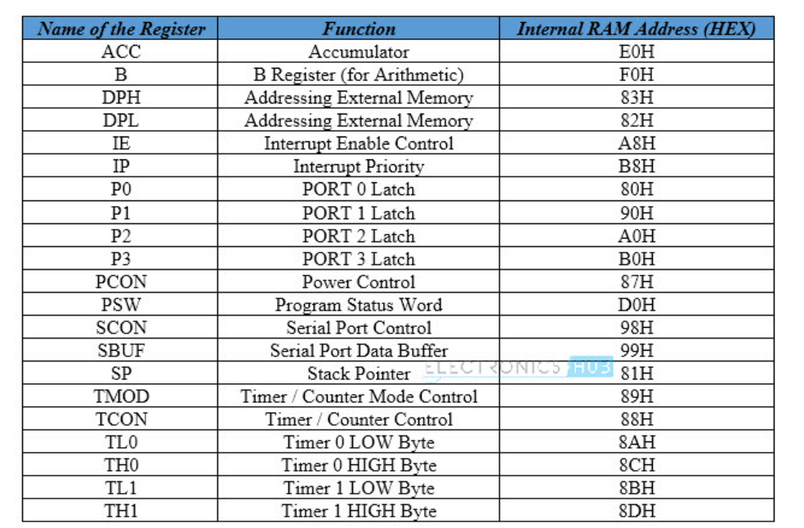

Slide 16
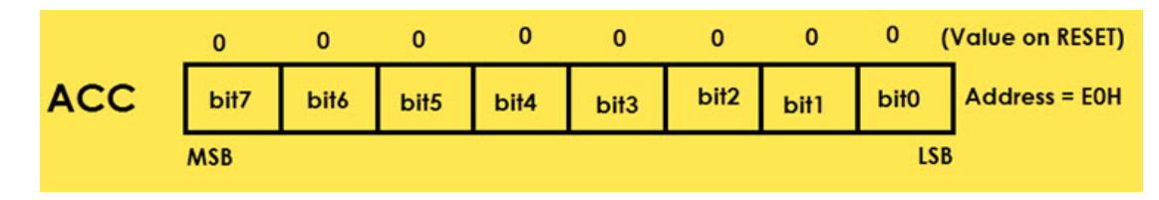
A or Accumulator (ACC)
Arithmetic Operations like Addition, Subtraction, Multiplication etc.
Logical Operations like AND, OR, NOT etc.
Data Transfer Operations (between 8051 and External Memory)
The name “Accumulator” came from the fact this register is used to accumulate (or store) the result of all Arithmetic and most of the Logical Operations.

Slide 17
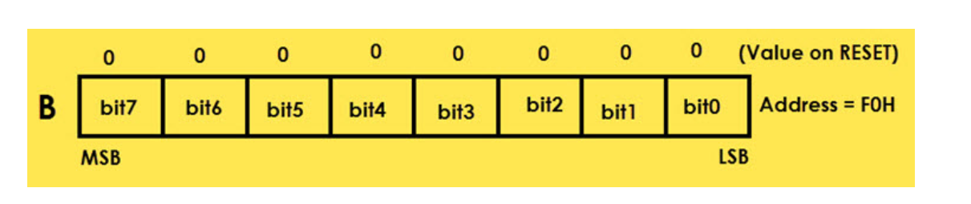
B (Register B)
The B Register is used along with the ACC in Multiplication and Division operations. These two operations are performed on data that are stored only in Registers A and B. During Multiplication Operation, one of the operand (multiplier or multiplicand) is stores in B Register and also the higher byte of the result.
In case of Division Operation, the B Register holds the divisor and also the remainder of the result. It can also be used as a General Purpose Register for normal operations and is often used as an Auxiliary Register by Programmers to store temporary results.
Register B is located at the address F0H of the SFR Address Space.

Slide 18
Program Status Word (PSW)
The PSW or Program Status Word Register is also called as Flag Register and is one of the important SFRs. The PSW Register consists of Flag Bits, which help the programmer in checking the condition of the result and also make decisions.
Flags are 1-bit storage elements that store and indicate the nature of the result that is generated by execution of certain instructions. The following image shows the contents of the PSW Register.

Slide 19
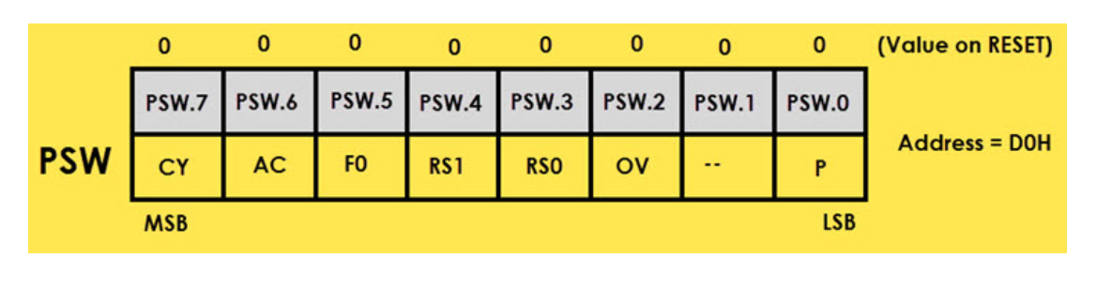
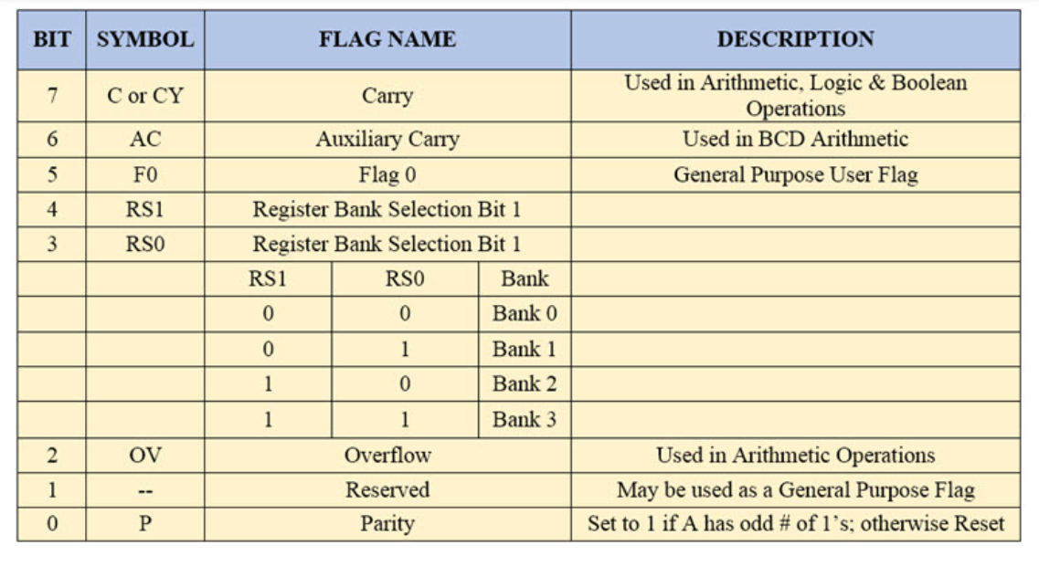

Slide 20
Pointer Registers
Data Pointer (DPTR – DPL and DPH)
The Data Pointer is a 16-bit Register and is physically the combination of DPL (Data Pointer Low) and DPH (Data Pointer High) SFRs. The Data Pointer can be used as a single 16-bit register (as DPTR) or two 8-bit registers (as DPL and DPH).
The DPTR Register is used by the programmer addressing external memory (Program – ROM or Data – RAM).

Slide 21
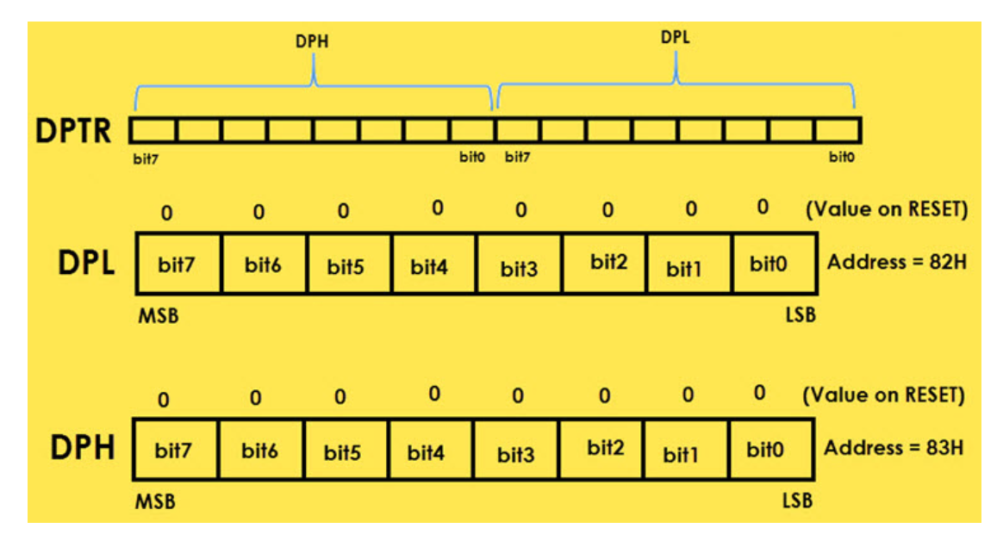

Slide 22
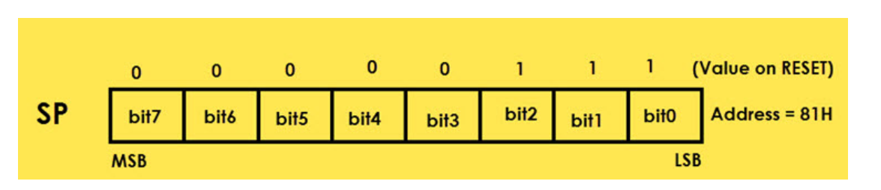
Stack Pointer (SP)
SP or Stack Pointer points out to the top of the Stack and it indicates the next data to be accessed. Stack Pointer can be accesses using PUSH, POP, CALL and RET Instructions. The Stack Pointer is an 8-bit register and upon reset, the Stack Pointer is initialized with 07H.

Slide 23
I/O Port Registers (P0, P1, P2 and P3)
The 8051 Microcontroller four Ports which can be used as Input and/or Output. These four ports are P0, P1, P2 and P3. Each Port has a corresponding register with same names (the Port Registers are also P0, P1, P2 and P3). The addresses of the Port Registers are as follows: P0 – 80H, P1 – 90H, P2 – A0H and P2 – B0H.
Each bit in these SFRs corresponds to one physical Pin in the 8051 Microcontroller. All these Port Registers are both Bit Addressable and Byte Addressable. Writing 1 or 0 on a Port Register Bit will reflect as an appropriate voltage (5V and 0V) on the corresponding Pin.

Slide 24
Peripheral Control Registers
The PCON or Power Control register, as the name suggests is used to control the 8051 Microcontroller’s Power Modes and is located at 87H of the SFR Memory Space. Using two bits in the PCON Register, the microcontroller can be set to Idle Mode and Power Down Mode.
During Idle Mode, the Microcontroller will stop the Clock Signal to the ALU (CPU) but it is given to other peripherals like Timer, Serial, Interrupts, etc. In order to terminate the Idle Mode, you have to use an Interrupt or Hardware Reset.
In the Power Down Mode, the oscillator will be stopped and the power will be reduced to 2V. To terminate the Power Down Mode, you have to use the Hardware Reset.

Slide 25

Bit | Symbol | Description | Additional Info
7 | SMOD | Serial Comm. Baud Rate Modify Bit | If 1, doubles the baud rate using Timer 1. If 0, normal timer 1 baud rate.
6 – 4 | —- | —
3 | GF1 | General Purpose User Flag (Bit 1)
2 | GF0 | General Purpose User Flag (Bit 0)
1 | PD | Power Down Bit | To enter Power Down Mode, set to 1
0 | IDL | Idle Mode Bit | To enter Idle Down Mode, set to 1

Slide 26
SCON (Serial Control)
The Serial Control or SCON SFR is used to control the 8051 Microcontroller’s Serial Port. It is located as an address of 98H. Using SCON, you can control the Operation Modes of the Serial Port, Baud Rate of the Serial Port and Send or Receive Data using Serial Port.
TCON (Timer Control)
Timer Control or TCON Register is used to start or stop the Timers of 8051 Microcontroller. It also contains bits to indicate if the Timers has overflowed. The TCON SFR also consists of Interrupt related bits.
TMOD (Timer Mode)
The TMOD or Timer Mode register or SFR is used to set the Operating Modes of the Timers T0 and T1. The lower four bits are used to configure Timer0 and the higher four bits are used to configure Timer1.

Slide 27
IE (Interrupt Enable)
The IE or Interrupt Enable Register is used to enable or disable individual interrupts. If a bit is SET, the corresponding interrupt is enabled and if the bit is cleared, the interrupt is disabled. The Bit7 of the IE register i.e., EA bit is used to enable or disable all the interrupts.
IP (Interrupt Priority)
The IP or Interrupt Priority Register is used to set the priority of the interrupt as High or Low. If a bit is CLEARED, the corresponding interrupt is assigned low priority and if the bit is SET, the interrupt is assigned high priority.

Slide 28
Peripheral Data Registers
SBUF (Serial Data Buffer)
The Serial Buffer or SBUF register is used to hold the serial data while transmission or reception.
TL0/TH0 (Timer 0 Low/High)
The Timer 0 consists of two SFRs: TL0 and TH0. The TL0 is the lower byte and the TH0 is the higher byte and together they form a 16-bit Timer0 Register.
TL1/TH1 (Timer 1 Low/High)
The TL1 and TH1 are the lower and higher bytes of the Timer 0

